Slide 1
Chapter 6
Multiple Radio Access

Slide 2
Outline
Introduction
Contention Protocols
ALOHA
Slotted ALOHA
CSMA (Carrier Sense Multiple Access)
CSMA/CD (CSMA with Collision Detection)
CSMA/CA (CSMA with Collision Avoidance)

Slide 3
Introduction
Multiple access control channels
  Each node is attached to a transmitter/receiver which communicates via a channel shared by other nodes
  Transmission from any node is received by other nodes
Node 3
Node 4
Node 2
Shared Multiple
Access Control
Channel to BS
…
Node 1
Node N

Slide 4
Introduction (Cont’d)
Multiple access issues
  If more than one node transmit at a time on the control channel to BS, a collision occurs
  How to determine which node can transmit to BS?
Multiple access protocols
  Solving multiple access issues
  Different types:
    Contention protocols resolve a collision after it occurs. These protocols execute a collision resolution protocol after each collision
    Collision-free protocols (e.g., a bit-map protocol and binary countdown) ensure that a collision can never occur.

Slide 5
Channel Sharing Techniques
Static Channelization
Channel Sharing Techniques
Scheduling
Dynamic Medium Access Control
Random Access

Slide 6
Classification of Multiple Access Protocols
Multiple access protocols
Contention-based
Conflict-free
Random access
Collision resolution
ALOHA,
CSMA,
BTMA,
ISMA, etc
TREE,
WINDOW, etc
FDMA,
TDMA,
CDMA,
Token Bus,
DQDB, etc
BTMA: Busy Tone Multiple Access
ISMA: Internet Streaming Media Alliance
DQDB: Distributed Queue Dual Bus

Slide 7
Contention Protocols
ALOHA
  Developed in the 1970s for a packet radio network by Hawaii University.
  Whenever a station has a data, it transmits. Sender finds out whether transmission was successful or experienced a collision by listening to the broadcast from the destination station. Sender retransmits after some random time if there is a collision.
Slotted ALOHA
  Improvement: Time is slotted and a packet can only be transmitted at the beginning of one slot. Thus, it can reduce the collision duration.

Slide 8
Contention Protocols (Cont’d)
CSMA (Carrier Sense Multiple Access)
  Improvement: Start transmission only if no transmission is ongoing
CSMA/CD (CSMA with Collision Detection)
  Improvement: Stop ongoing transmission if a collision is detected
CSMA/CA (CSMA with Collision Avoidance)
  Improvement: Wait a random time and try again when carrier is quiet. If still quiet, then transmit
CSMA/CA with ACK
CSMA/CA with RTS/CTS

Slide 9
ALOHA
Node 1 Packet
Waiting a random time
Node 2 Packet
Retransmission
Retransmission
1
2
3
3
2
Time
Collision
Node 3 Packet
Collision mechanism in ALOHA

Slide 10


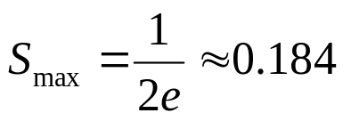
Throughput of ALOHA
The probability that n packets arrive in two packets time is given by
(2G)
n
e
−
2
G
P
(
n
)
=
n
!
where G is traffic load.
The probability P(0) that a packet is successfully received without collision is calculated by letting n=0 in the above equation. We get
We can calculate throughput S with a traffic load G as follows:
The Maximum throughput of ALOHA is

Slide 11
Slotted ALOHA
Node 1 Packet
Nodes 2 & 3 Packets
Retransmission
Retransmission
1
2&3
2
3
Time
Slot
Collision
Collision mechanism in slotted ALOHA

Slide 12


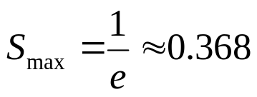
Throughput of Slotted ALOHA
The probability of no collision is given by
The throughput S is
The Maximum throughput of slotted ALOHA is

Slide 13
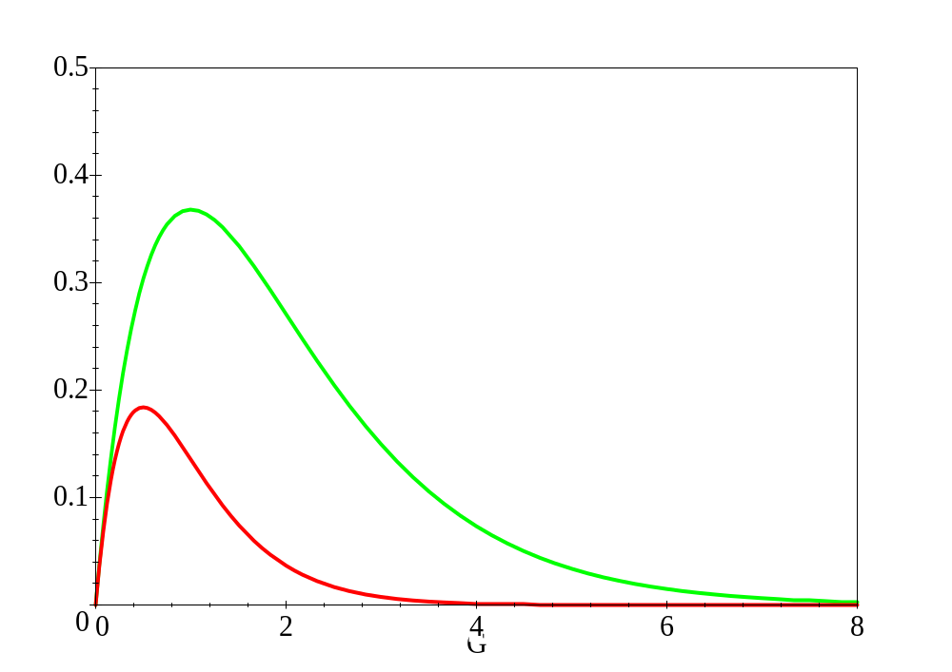
Throughput
0.368
S
Slotted Aloha
0.184
Aloha
G

Slide 14
CSMA (Carrier Sense Multiple Access)
Max throughput achievable by slotted ALOHA is 0.368.
CSMA gives improved throughput compared to Aloha protocols.
Listens to the channel before transmitting a packet (avoid avoidable collisions).

Slide 15
Collision Mechanism in CSMA
Node 5 sense
Node 1 Packet
Node 2 Packet
Node 3 Packet
Delay
1
2
3
4
5
Time
Delay
Collision
Node 4 sense

Slide 16
Kinds of CSMA
Unslotted Nonpersistent CSMA
Nonpersistent CSMA
Slotted Nonpersistent CSMA
CSMA
Unslotted persistent CSMA
Persistent CSMA
Slotted persistent CSMA
1-persistent CSMA
p-persistent CSMA

Slide 17
Nonpersistent/x-persistent CSMA Protocols
Nonpersistent CSMA Protocol:
Step 1: If the medium is idle, transmit immediately
Step 2: If the medium is busy, wait a random amount of time and repeat Step 1
  Random backoff reduces probability of collisions
  Waste idle time if the backoff time is too long
1-persistent CSMA Protocol:
Step 1: If the medium is idle, transmit immediately
Step 2: If the medium is busy, continue to listen until medium becomes idle, and then transmit immediately
  There will always be a collision if two nodes want to retransmit
  (usually you stop transmission attempts after few tries)

Slide 18
Nonpersistent/x-persistent CSMA Protocols
p-persistent CSMA Protocol:
Step 1: If the medium is idle, transmit with probability p, and delay for worst case propagation delay for one packet with probability (1-p)
Step 2: If the medium is busy, continue to listen until medium becomes idle, then go to Step 1
Step 3: If transmission is delayed by one time slot, continue with Step 1
  A good tradeoff between nonpersistent and 1-persistent CSMA

Slide 19
How to Select Probability p ?
Assume that N nodes have a packet to send and the medium is busy
Then, Np is the expected number of nodes that will attempt to transmit once the medium becomes idle
If Np > 1, then a collision is expected to occur
Therefore, network must make sure that Np < 1 to avoid collision, where N is the maximum number of nodes that can be active at a time

Slide 20
Throughput
1.0
0.9
0.8
0.7
0.6
0.5
0.4
0.3
0.2
0.1
0
0.01-persistent CSMA
Nonpersistent CSMA
0.1-persistent CSMA
0.5-persistent CSMA
S
1-persistent CSMA
Slotted Aloha
Aloha
0 1 2 3 4 5 6 7 8 9
G

Slide 21
CSMA/CD (CSMA with Collision Detection)
In CSMA, if 2 terminals begin sending packet at the same time, each will transmit its complete packet (although collision is taking place).
Wasting medium for an entire packet time.
CSMA/CD
Step 1: If the medium is idle, transmit
Step 2: If the medium is busy, continue to listen until the channel is idle then transmit
Step 3: If a collision is detected during transmission, cease transmitting
Step 4: Wait a random amount of time and repeats the same algorithm

Slide 22
CSMA/CD (Cont’d)
T₀
A begins transmission
A
B
T₀+α-ε
B begins transmission
A
B
T₀+α
B detects collision
A
B
T₀+2α -ε
A detects collision just before end of transmission
A
B
Time
(α is the propagation time)

Slide 23
CSMA/CA (CSMA with collision Avoidance)
All terminals listen to the same medium as CSMA/CD.
Terminal ready to transmit senses the medium.
If medium is busy it waits until the end of current transmission.
It again waits for an additional predetermined time period DIFS (Distributed inter frame Space).
Then picks up a random number of slots (the initial value of backoff counter) within a contention window to wait before transmitting its frame.
If there are transmissions by other terminals during this time period (backoff time), the terminal freezes its counter.
It resumes count down after other terminals finish transmission + DIFS. The terminal can start its transmission when the counter reaches to zero.

Slide 24
CSMA/CA (Cont’d)
Node A’s frame
Node B’s frame
Node C’s frame
Delay: B
Delay: C
Time
Nodes B & C sense the medium
Nodes C starts transmitting.
Nodes B resenses the medium and transmits its frame.
Node C freezes its counter.
Nodes C resenses the medium and starts decrementing its counter.

Slide 25
CSMA/CA Explained
DIFS
DIFS
Contention window
Contention
window
Medium Busy
Next Frame
Time
Defer access
Slot
Backoff after defer
DIFS – Distributed Inter Frame Spacing

Slide 26
CSMA/CA with ACK
Immediate Acknowledgements from receiver upon reception of data frame without any need for sensing the medium.
ACK frame transmitted after time interval SIFS (Short Inter-Frame Space) (SIFS < DIFS)
Receiver transmits ACK without sensing the medium.
If ACK is lost, retransmission done.

Slide 27
CSMA/CA/ACK
DIFS
Time
Data
Source
SIFS
ACK
Destination
DIFS
Contention window
Next Frame
Other
Defer access
Backoff after defer
SIFS – Short Inter Frame Spacing

Slide 28
CSMA/CA with RTS/CTS
Transmitter sends an RTS (request to send) after medium has been idle for time interval more than DIFS.
Receiver responds with CTS (clear to send) after medium has been idle for SIFS.
Then Data is exchanged.
RTS/CTS is used for reserving channel for data transmission so that the collision can only occur in control message.

Slide 29
CSMA/CA with RTS/CTS (Cont’d)
DIFS
SIFS
Data
Time
Source
RTS
SIFS
SIFS
Destination
CTS
ACK
DIFS
Contention window
Next Frame
Other
Defer access
Backoff after defer

Slide 30
RTS/CTS
Node A
Node B
Propagation delay
RTS
CTS
Data
ACK

